Slide 1
Automated YouTube Transcript Downloader
Efficiently Generate Transcripts from Multiple YouTube Videos

Slide 2

Introduction
Problem Statement: Manually creating scripts from multiple video sources is time-consuming and often inconsistent.
Solution: Develop an automated system to generate accurate, cohesive, and well-structured scripts from multiple YouTube videos.

Slide 3
Create an automated system to fetch and process transcripts from YouTube videos.
Objectives
Use YouTube Transcript API and Google Gemini API for advanced language processing.
Provide a user-friendly interface for inputting YouTube links and downloading transcripts.

Slide 4
Multi-Video Input: Input up to 5 YouTube links.
Key Features
Transcript API Integration: Fetch transcripts from YouTube videos.

Slide 5
Implementation Steps
User Input: Interface for YouTube links.
API Integration: Fetch transcripts using YouTube Transcript API.
Data Processing: Clean and preprocess transcripts.
NLP Analysis: Analyze and synthesize transcripts.
Script Generation: Generate a cohesive script.
Output and Review: Provide script for review and editing.

Slide 6
GUI Application
Description: A simple Python GUI for inputting YouTube links and downloading transcripts as a text file.
Libraries Used: tkinter, youtube-transcript-api

Slide 7
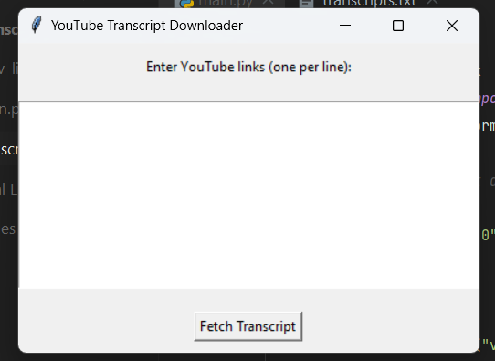
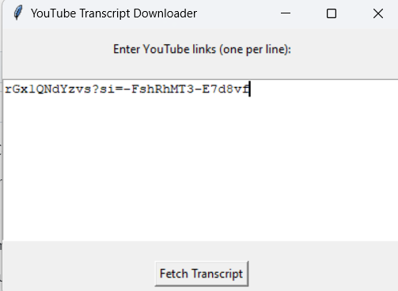
Demo - GUI Application

Slide 8
Additional Features
Error Handling: Basic error notifications.
Customization Options: Select output file location, advanced error handling, UI enhancements.
Further Development: Robust NLP techniques for transcript processing, combining transcripts into a cohesive document.

Slide 9
Conclusion
Summary: Automated system for efficient transcript generation.
Benefits: Time-saving, improved script quality, user-friendly interface.
Future Work: Explore more advanced features and enhancements.

Slide 10
Contact Information
Rakib Hasan Rahad
rahadrakib4@gmail.com
www.linkedin.com/in/rakib-hasan-rahad

